Slide 1

Social Media Police
Restoring Trust in the Feed: A Client-Side Forensic Repository

Slide 2



The Landscape: Trust in Crisis
Social media feeds are facing an unprecedented crisis of authenticity, driven by three converging factors:
The AI Flood: Generative AI creates synthetic "slop" engagement bait that mimics human sentiment perfectly.
The Misinformation Gap: Fact-checking typically occurs hours after a post has gone viral, too late to stop the spread.
Walled Gardens: Platforms like Facebook restrict API access, preventing traditional server-side analysis tools from working.

Slide 3

The Solution: The Client-Side Observer
If we can't access the API, we go to the source: The Browser.
Our solution is a browser extension that acts as a beat officer on the user's screen. It bypasses API restrictions by analyzing content directly from the DOM as it renders.
It observes, analyzes, and injects a forensic "badge" onto posts in real-time, giving users immediate verification without platform permission. The results are saved into a local DB.

Slide 4

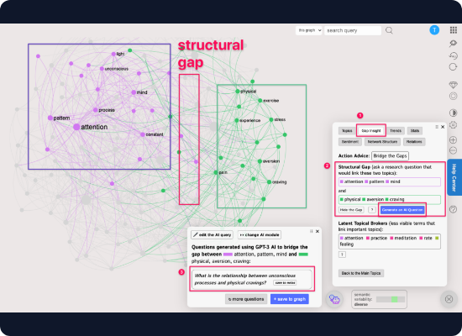
Phase 1: The AI Slope (Detection)
How do we spot a bot? We look for the absence of humanity.
Perplexity Analysis: Measures the "surprise" of the text. AI models are predictable (low perplexity) and mostly do not have spelling mistakes, humans are chaotic.
Burstiness: AI writes in uniform sentence lengths, humans are chaotic.
Emotions: Robots are cold, humans are chaotic.

Slide 5

Phase 2: The Truth Serum (Verification)
We don't just guess; we verify. This module uses a RAG (Retrieval-Augmented Generation) pipeline.
Claim Extraction: An LLM strips the post down to atomic, testable claims (e.g., "Mayor released sharks").
Evidence Retrieval: The system queries and fact check for live context.
Adjudication: A "Judge" LLM compares the claim against the evidence to issue a verdict: True, False, or Opinion.

Slide 6






Under the Hood: Tech Stack
Backend Core
Frontend Agent
Intelligence
JS provides the async capabilities needed to handle long-running search queries without blocking other users.
Manifest V3 (JS) ensures compliance with modern browser security while allowing powerful DOM manipulation.
Various models provide the inference engines for both stylistic analysis and semantic reasoning.

Slide 7
Data Flow: From Feed to Verdict
1. Observe: User scrolls. Extension detects relevant info and scrape the text.
2. Transmit: Text payload is sent securely to the Python API.
3. Process: Server hashes text (caching), runs AI Slope, then Truth Serum.
4. Response: Server returns a JSON verdict object (AI score, Facts check).
5. Inject: Extension paints a colorful border and badge onto the post.

Slide 8




Engineering Challenges
DOM Obfuscation
Facebook randomizes CSS classes. We use structural heuristics instead of brittle class names.
API limit
Meta limits bot scrapping and free API calls. We overcome their limitation with creative and sophisticated overlays.

Slide 9
"We don't wait for the platform to moderate. We give the user the tools to see the truth instantly."
— Bot Father

Slide 10

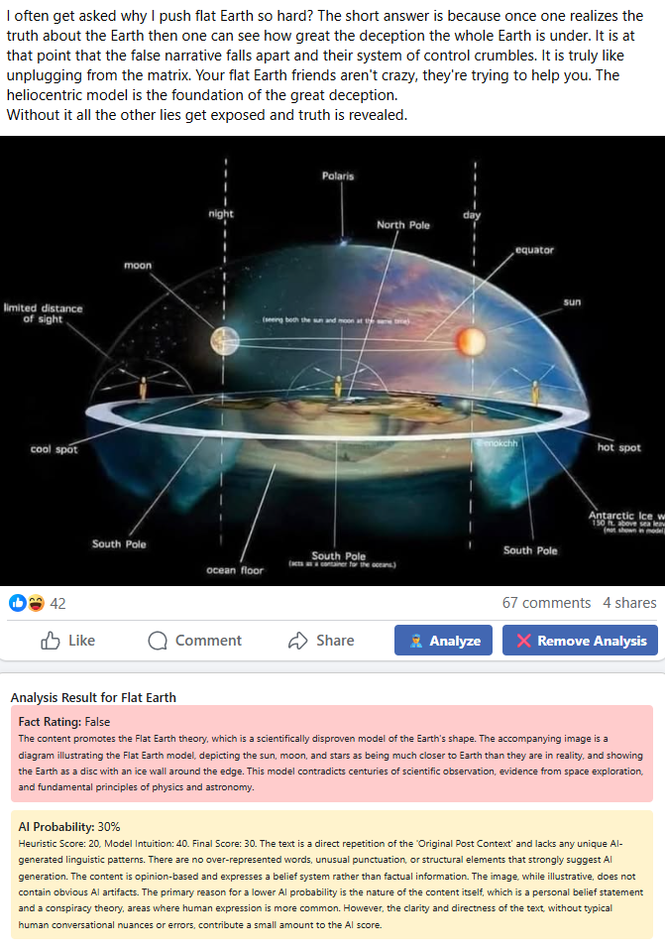

Slide 11
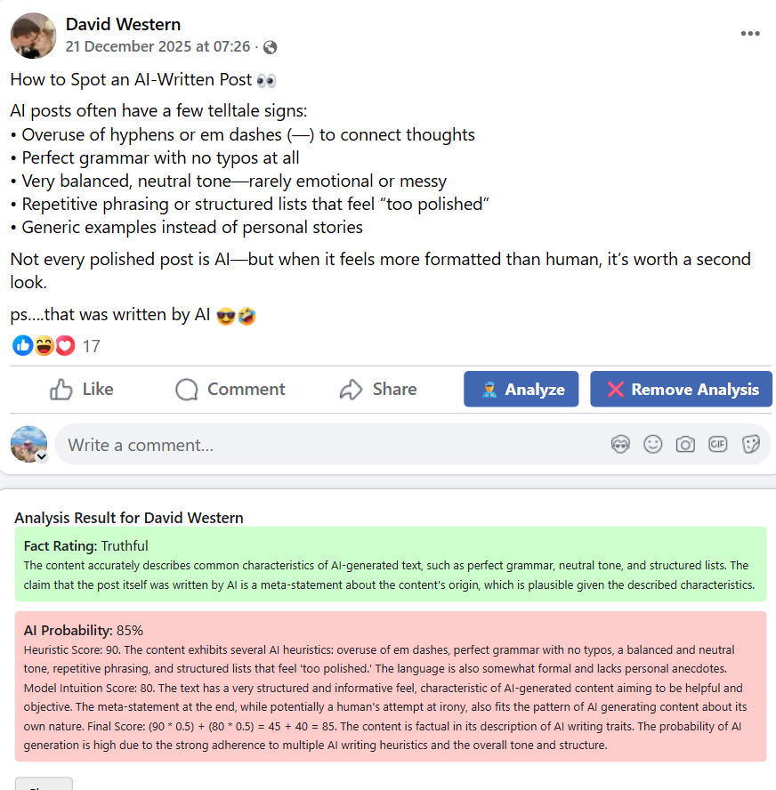
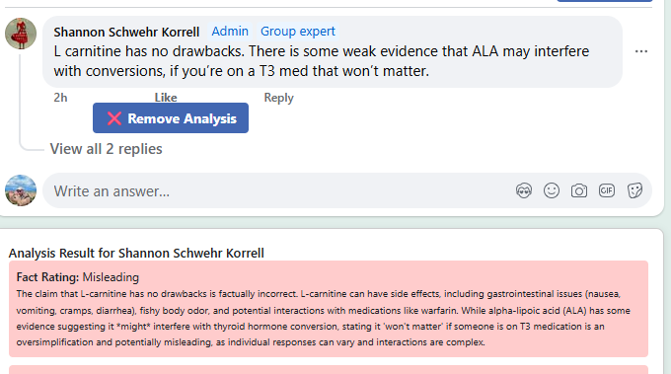
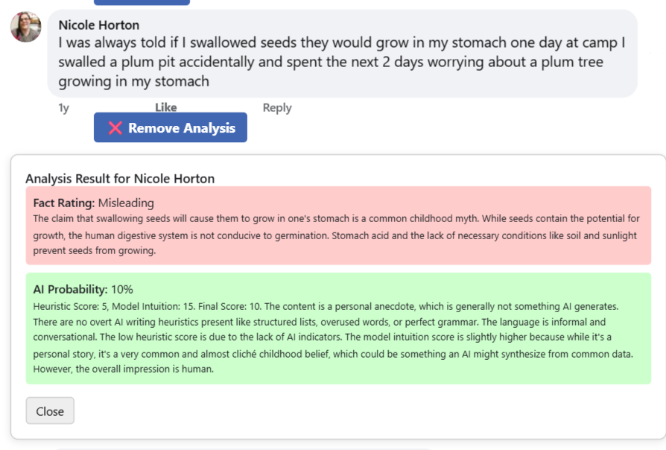

Slide 12
Questions?
Ready to deploy the beat officers.
https://github.com/VitalyChait/SocialPolicy | chaitvitaly@gmail.com

